Slide 1

AI Agent Supported
Software Development
Patrik Zsolt Hajdú · BME AUT · 2026 · Tibor Tóth

Slide 2
Motivation & Topic Choice
The Problem 1/4
The Goal 2/4
One of my family members works at an auto repair shop and uses Google Sheets, which is difficult to maintain and is not scalable.
Build a real, production-ready scheduling tool (ARSM).
The Method 3/4
Why AI? 4/4
Move from manual "copy-paste" coding to controlled AI workflows.
Testing the limits of deterministic code generation for real business logic.

Slide 3




AI Prompting in Practice
Zero-Shot
Few-Shot
Chain of Thought
Result
Good for theory, bad for coding causes "hallucinations".
Better for coding, but fills up the context window fast.
Iterative dialogue, step-by-step reasoning.
Engineering decisions stayed in my hands, not the AI's.
WINNER

Slide 4
From Chat to AI Agents
Patrik
Orchestrator
Architecture & SOLID rules
Reactive (Chat)
Proactive (Agents)
Mark & Gergely
Just answers questions on demand.
Execute autonomously: read files, run tests, validate builds.
Backend / Frontend
.NET 10 REST API · React 19
Zsombor
DevSecOps
Security & build validation

Slide 5
The Multi-Agent Workflow
Strict Harness: Agents bound by .github/agents/… and .claude/agents/…
01
02
03
04
Analyze & Plan
Execute
Validate
Sync
Orchestrator breaks tasks into subtasks
Specialists implement code within their sandbox
Auto-run dotnet build & tsc for instant feedback
docs-sync updates README.md, CLAUDE.md and instruction.md to prevent doc drift

Slide 6




ARSM Architecture
Orchestration
Backend
.NET 10 Aspire
.NET 10 REST API
Docker container management and service discovery
Entity Framework Core ·TPH Pattern
Database
Database
PostgreSQL
React 19 · Vite · Tailwind CSS4
Persistent volume · EF Core migrations
Zustand state management

Slide 7




Why This Stack?
.NET Aspire
JWT Security
Dynamic connection string injection no static config errors.
HttpOnly/Secure cookies + DB-backed Denylist (XSS protection).
Table-Per-Hierarchy (TPH)
Tailwind + React
Clean separation of Mechanics and Customers in a single DB table.
Rapid, predictable styling enforced by dedicated UI/UX agents.

Slide 8
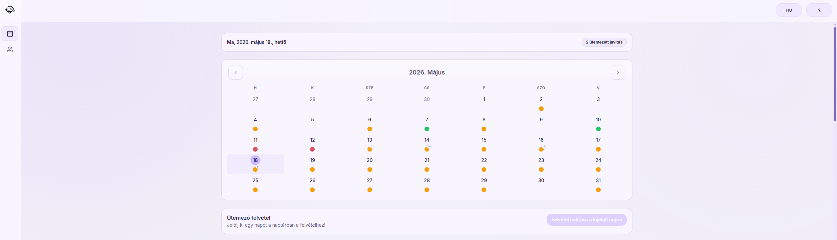

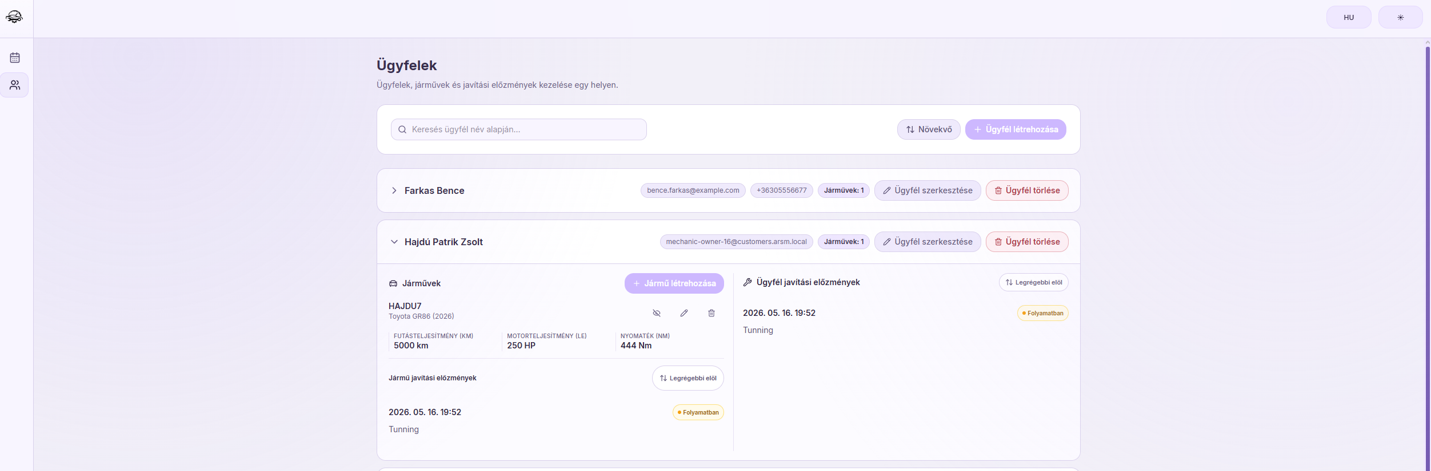



The ARSM Project
Core Logic
Handling Arrival Time and Due Date for every appointment.
Scheduling Engine
Smart resource allocation across mechanics and service bays.
Registry
Managing Customer data and Vehicle specifications.

Slide 9




Key Features & AI Solutions
Zero-Orphan State Machine
Role-Based Access
A task can never be left without an assigned mechanic guaranteed by design.
Admins assign; Mechanics claim or unclaim tasks no manual admin bottleneck.
320px Mobile UI
CI/CD Pipeline
AI-enforced "Less is More" responsive design using min-w-0 & truncate utilities.
Matrix build + Health-check
Backend and Frontend transitive dependency check

Slide 10




Key Takeaways & Thesis Roadmap
Mindset Shift
Testing Focus
From manual programmer to "System Orchestrator" delegating execution to AI agents.
Next step: full Playwright E2E integration for real coverage and confidence.
Production Deployment
Local LLM Research
Moving ARSM to a live server real-world validation for the family business.
RTX 4090 (16GB VRAM) + i9-14900K for fully local, secure agent execution.

Slide 11
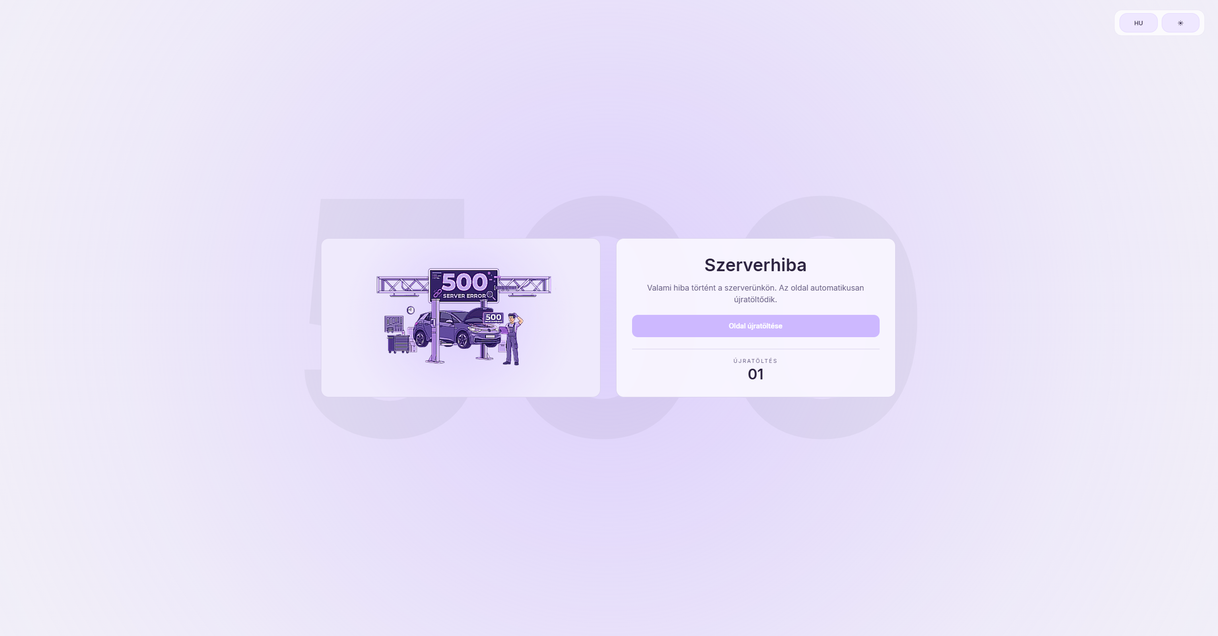
Any Questions?
Thank you for your attention!

